Slide 1
RPA PROJECT
Weather report automation
Magizhan sivakumar cse-c
220701154

Slide 2
ABSTRACT
This project automates the collection and distribution of weather reports using Robotic Process Automation (RPA). The RPA bot gathers weather data from reliable sources, processes it, and distributes it in real-time through various channels like email and SMS. This automation reduces manual effort, minimizes errors, and delivers timely weather updates for sectors such as agriculture, logistics, and event management. The project demonstrates how RPA can streamline data handling, ensuring efficiency and accuracy in delivering critical weather information.

Slide 3
objective
The objective of a weather report automation RPA project is to streamline the collection, processing, and delivery of accurate weather data. Key goals include:
Automate Data Collection: Pull real-time data from reliable sources.
Generate Reports: Produce user-friendly, customizable weather summaries.
Efficient Delivery: Send updates via email, SMS, or dashboards.
Reduce Manual Effort: Minimize errors and improve efficiency.
Ensure Scalability: Integrate with business systems and handle larger data sets as needed.
This automation aims to make weather reporting quick, reliable, and adaptable to business needs.

Slide 4
workflow
Define Requirements: Identify user needs, data sources, and delivery methods.
Design Bot Workflow: Outline data collection, processing, and report generation steps.
Automate Data Collection: Set up scheduled data retrieval from weather sources.
Process Data: Standardize and clean data for accuracy and consistency.
Generate Reports: Configure report formats (PDF, email, etc.).
Deliver Reports: Automate delivery via email, SMS, or dashboard with alert triggers.
Monitor and Log: Track performance, accuracy, and maintain logs for audits.
Test and Deploy: Validate bot function and release for production use.
This streamlined workflow ensures efficient and accurate weather report automation.

Slide 5
advantages
Time Efficiency: Eliminates manual data collection and report generation, freeing up staff for other tasks.
Accuracy: Reduces human errors in data handling, ensuring reliable weather insights.
Real-Time Updates: Provides timely alerts for critical weather conditions, enhancing decision-making.
Cost Savings: Lowers operational costs by minimizing manual work and errors.
Scalability: Easily adapts to increased data sources or expanded geographic coverage.
Customization: Delivers tailored reports to meet specific user requirements and formats.
Improved Compliance: Ensures data tracking and logs for transparency and audit readiness.
Overall, this project enhances productivity, accuracy, and responsiveness in weather reporting.

Slide 6
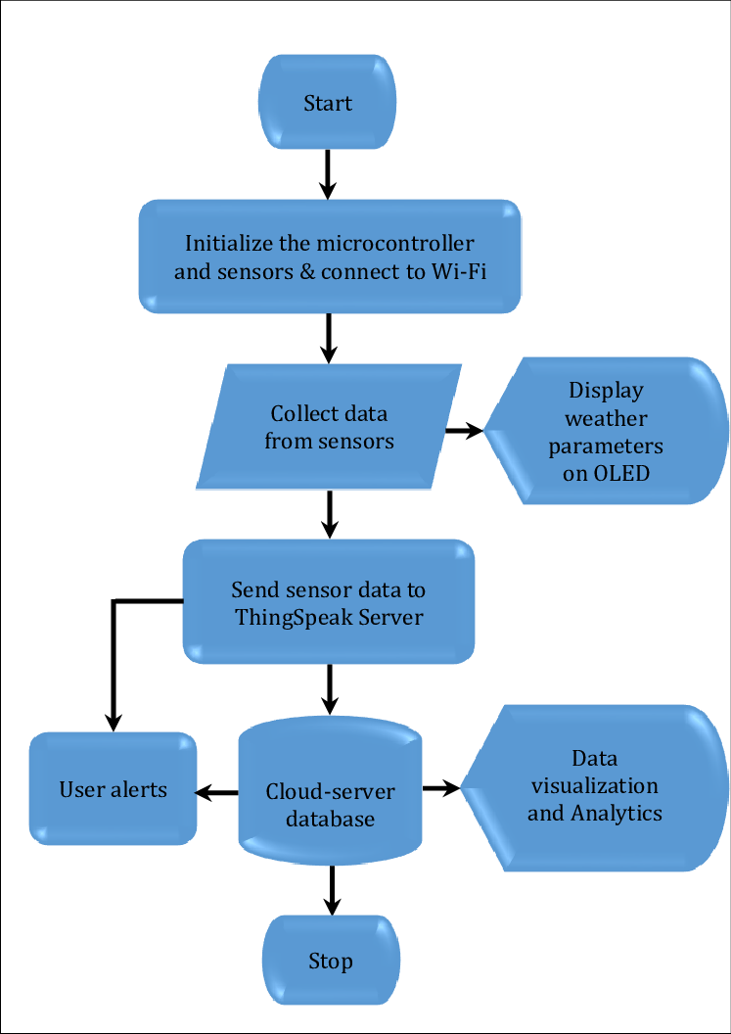
System flow diagram

Slide 7
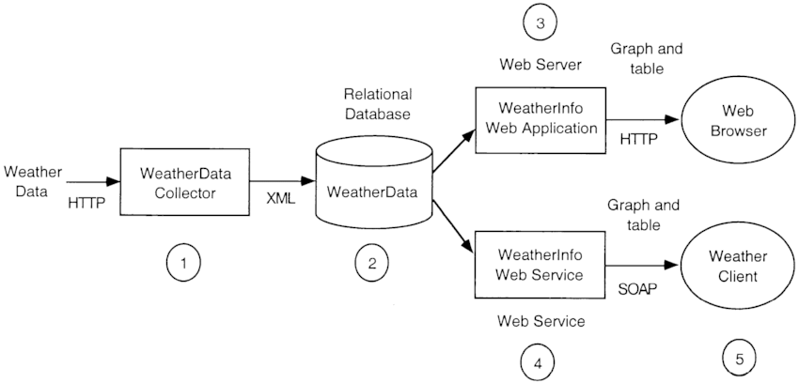
Architecture diagram

Slide 8
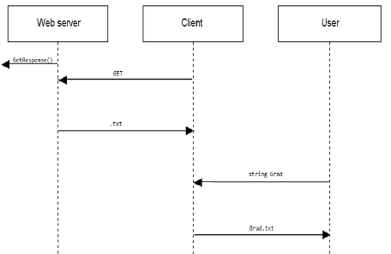
Sequence diagram

Slide 9
conclusion
The weather report automation RPA project streamlines the entire process of weather data collection, processing, and reporting, providing timely and accurate updates. By minimizing manual work and reducing human error, the system enhances operational efficiency, responsiveness, and scalability, making it a valuable tool for businesses and organizations that rely on up-to-date weather information. This automation supports informed decision-making and prepares organizations to respond effectively to changing weather conditions. With these benefits, the project represents a strategic move towards improved productivity and reliable reporting.

